Slide 1

Navigating AI in Nonprofits: Best Practices and Policy Development

Slide 2

Your Facilitator
Lori Gracey, CAE
TCEA Executive Director
lgracey@tcea.org
Twitter/X @TCEA and @lgracey
https://www.tcea.org

Slide 3


Slide 4
Agenda
A Quick Look at AI Today
It’s All About the Chatbots!
Powerful AI Use Cases
A Few Tools to Try Out
Developing an AI Policy
Moving from Novel to Normal
Next Steps and Resources

Slide 5

Today’s Resources
https://shorturl.at/j2uLE

Slide 6

AI Right Now

Slide 7
AI Can or Can’t?
Do you think today's best general AI (as of mid-2024) can or can't do this task? Think along the lines of OpenAI's ChatGPT, Google's Gemini, or Anthropic's Claude.
What is 79² × 38.25? Break it down step by step.
The AI is asked to do some arithmetic. And we're asking it to show its work.
Notes:
It can!
https://theaidigest.org/ai-can-or-cant

Slide 8

AI Can or Can’t?
Create a simple calculator app.
The AI is asked to output code, and then we'll run it and see if it works.
Notes:
It can!

Slide 9
AI Can or Can’t?
What is the most populous city in Colorado north of Denver?
The answer is Fort Collins. Can AI get this right without searching the web and just relying on what is learned during training?
Notes:
It can!

Slide 10

AI Can or Can’t?
What is the most populous city or town in Colorado north of Fort Collins?
This is trickier than before. The answer is a city in northeastern Colorado called Sterling.
Notes:
It can’t.

Slide 11
AI Can or Can’t?
Create a color palette generator.
The AI is asked to create a website that (a) generates a random color palette, (b) lets the user save and delete palettes, and (c) lets the user generate a new palette similar to a saved palette.
Notes:
It can!

Slide 12
AI Can or Can’t?
Create a weather app.
The AI is asked to create a weather app that (i) uses the Open Metro API to display the current temperature and wind speed and (ii) displays this information using tabs, with a tab for San Francisco, New York, and the user's current location.
Notes:
It can!

Slide 13
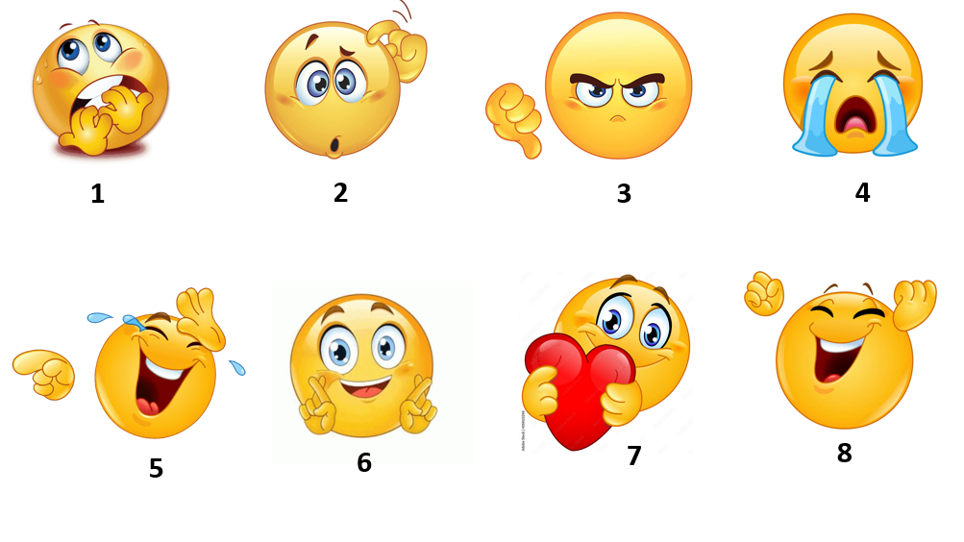

Slide 14

Where Is Your Organization Now with the Implementation of AI?
On a scale of 1 to 6, with 1 being “not at all” and 6 being “fully internalized and implemented,” where is your organization right now with the use of AI? Why is that?

Slide 15
Stats
95% of workers see value in working with generative AI. (Accenture report)
80% of workers want to know how to use AI in their profession. (LinkedIn report)‍
79% of leaders agree their company needs to adopt AI to stay competitive. (Microsoft report)
Consultants using AI finished 12.2% more tasks on average, completed tasks 25.1% more quickly, and produced 40% higher quality results than those without. (Wharton University of Pennsylvania report)

Slide 16
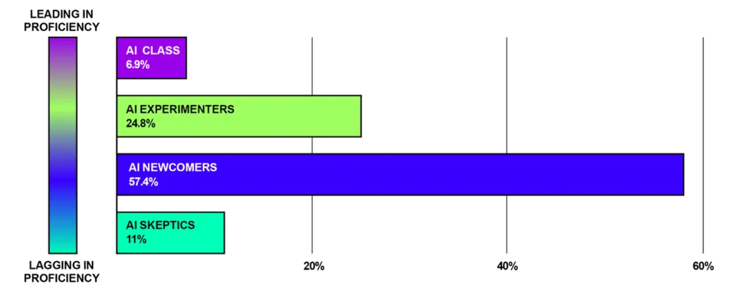
AI Proficiency Report: Where Do You Rank?
Notes:
https://drive.google.com/file/d/1LetQvDpZ3zH4fxWwUZXfUe6n7yn9NjxM/view?usp=drive_link

Slide 17

AI Skeptics
Skeptics, as you might imagine, almost never use AI and they’re not saving any time with it. They haven’t received formal training (93%), and their prompting skills are the worst of the bunch. Most of their employers (44%) won’t take a stance on AI.

Slide 18

AI Newcomers
The majority of the workforce are what we call “AI Newcomers.” They use AI a few times a month – usually the free version of ChatGPT – and they’re saving maybe 5-10% of their time each week. They have received no formal training on AI.

Slide 19

AI Experimenters
Experimenters haven’t fully integrated AI into their daily work but use it once a week and report small productivity gains (a few hours a week). They use a mix of paid and free AI tools (70%). They are basic prompters (in the 62nd percentile for prompt effectiveness). The majority (29%) are saving 10-20% of their time each week with AI.

Slide 20

AI Class
They’re master prompters. We gave all survey respondents a test: We told them to prompt ChatGPT to accomplish a task and scored them out of 10 based on their response’s structure, clarity, and use of context. The majority of the workforce average a score of 2.7. The AI Class average an 8.6.
They use AI for everything – not just the well-known use cases like email subject lines and blog post brainstorming. They use AI to analyze their data to gain unique insights, get a different perspective on their work, and offload their repetitive tasks.
They use it everyday, and they don’t settle for free models. 89% of AI Class members use AI daily at work vs. just 10% of AI Newcomers
AI Class users save up to 12 hours a week because of how they use AI.

Slide 21
The Biggest Drivers of AI Proficiency: The Organization
Approval
95% of the AI Class are in organizations who openly approve of the use of AI. In contrast, most Skeptics are not in companies that ban AI, but in companies who won’t take a stance on it.
Support
Only 2% of people who received formal company training remain a Skeptic. 50% of people in the AI class have received formal training.
Access
The most productive AI users have access to organization- or team-wide LLMs.

Slide 22


Slide 23

Taking Chatbots to the Next Level

Slide 24
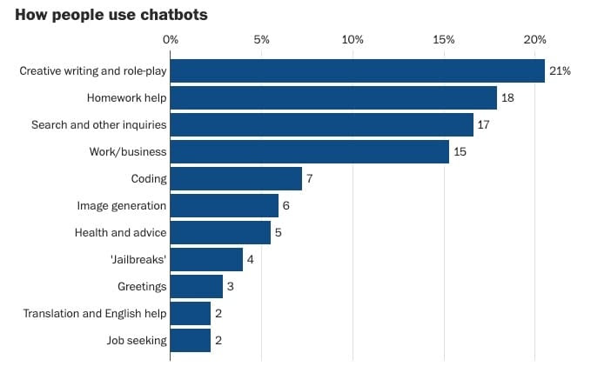
Notes:
Washington Post article: https://www.washingtonpost.com/technology/2024/08/04/chatgpt-use-real-ai-chatbot-conversations/

Slide 25
Who’s Good at What?
Notes:
Chatbot Comparison as of 9-3-24 resource (https://drive.google.com/file/d/1wpIqHfVB02ZERKn_hHT9tvJ9xWWZLL-i/view?usp=drive_link)

Slide 26


Slide 27
General Prompting Tips
Structure your prompts with #1 Persona, #2 Task, #3 Context, and #4 Format.
01
Use natural language and specific requests (like tone and constraints).
02
Break complex tasks into smaller prompts.
03

Slide 28
Chatbot Prompts to Use
Useful Prompts for Chatbots from TCEA
Claude’s Prompt Library

Slide 29
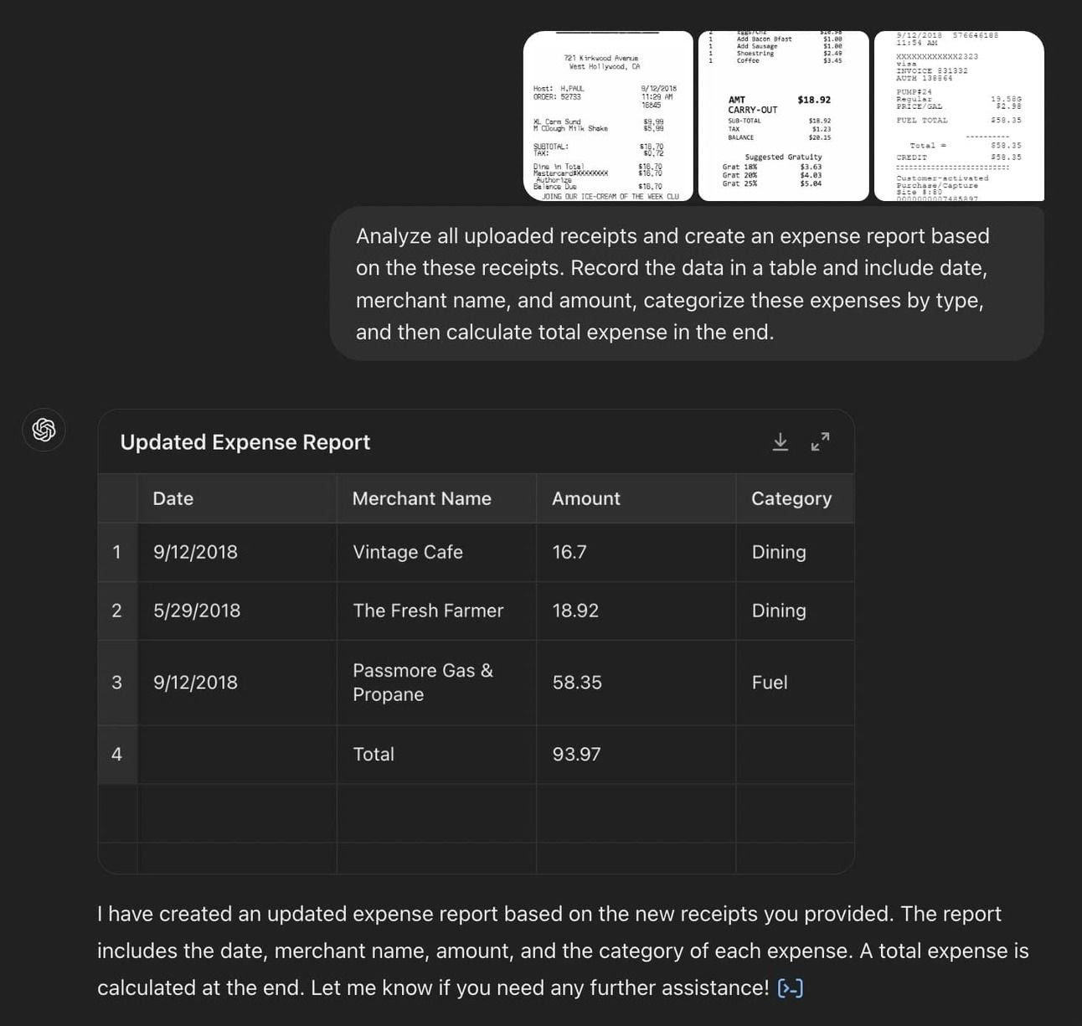
If You Ask It, It Will Come!
Notes:
Go to ChatGPT and log in with your account.
Make sure you choose GPT-4o as your model.
Now upload images of all your receipts and ask ChatGPT to analyze and convert them into an expense report.
Use the prompt: “Analyze all uploaded receipts and create an expense report based on these receipts. Record the data in a table, including date, merchant name, and amount, categorize these expenses by type, and then calculate the total expense.”
You can convert this report into a PDF or a CSV file to download it.

Slide 30
Prompt Chaining
Break down complex tasks into a series of interconnected prompts.
Example: Determine Where Social Media Posts Will Be Most Effective
"List the top three social media platforms popular among [your audience]."
“Now, for each platform, describe its main features and target audience."
“Based on the previous prompts, explain how each platform's design might influence user behavior."
“Finally, suggest strategies for marketing [event or product] based on this analysis. Include which social media platform will be the best to post on and provide some sample posts targeting the [event or product]."

Slide 31
Iterative Refinement
Start with a basic prompt and gradually refine it to add depth, detail, and specific focuses.
Example: Craft a Compelling Call to Action Initial Prompt:
"Write a call-to-action paragraph to get educators to register for [event and organization]."
Refinement 1: "Rewrite the paragraph, focusing on the value this event will provide for career advancement."
Refinement 2: "Modify the paragraph to introduce the highlights of the event."
Refinement 3: "Adjust the tone of the paragraph to create a sense of [excitement and urgency].”

Slide 32
Multi-Angle Problem Solving
Approach complex issues from various disciplinary perspectives.
Example: Improving High School Education
Pedagogical Angle: "Discuss modern teaching methodologies that could enhance high school education."
Technological Angle: "Explain how integrating technology in classrooms could improve learning outcomes."
Psychological Angle: "Analyze the role of student motivation and mental health in academic performance."
Sociological Angle: "Examine how socioeconomic factors influence educational opportunities and potential solutions."

Slide 33
Prompt Chains and Bulk Prompting
Prompt chains are sequences of prompts for LLMs that help build context for the AI before having it perform a task.
Advanced users may want to consider using a Chrome extension like ChatGPT Que to save time with longer prompt chains and bulk prompting. ($13.99/lifetime license)

Slide 34
Prompt Chain Example: Create a How-To Guide
TOPIC=[subject of the guide], SKILLLEVEL=[beginner/intermediate/advanced], FORMAT=[blog post/video script/infographic]
Research and list the top 5-10 most common questions or pain points people have when learning about or attempting TOPIC. ~ Create an outline for the how-to guide, breaking TOPIC down into 5-7 main steps or sections. Ensure the complexity matches SKILLLEVEL.~ Write an engaging introduction that explains why TOPIC is important or beneficial, and what the reader will learn by the end of the guide.~ For each main step or section:
Provide a clear, concise explanation of what needs to be done.
Include any necessary warnings or preparatory steps.
Offer 2-3 tips or best practices related to this step.
If applicable, suggest tools or resources that can help with this step.
~ Identify potential challenges or common mistakes related to TOPIC. Create a troubleshooting section addressing these issues with solutions
.~ Develop a list of Frequently Asked Questions (FAQs) about TOPIC, complete with clear, concise answers.
~ Create a section on "Next Steps" or "Advanced Techniques" for readers who want to go beyond the basics of TOPIC.
~ If TOPIC involves any technical terms or jargon, create a glossary defining these terms in simple language.
~ Based on FORMAT, suggest appropriate visual aids (e.g., diagrams, screenshots, or video timestamps) to supplement the written content at key points in the guide.
~ Write a conclusion that summarizes the key points of the guide and encourages the reader to put their new knowledge into practice.
~ Compile all sections into a complete how-to guide formatted appropriately for FORMAT. Include a table of contents if it's a longer piece.

Slide 35
Prompt Chain Example: Build an SEO-Optimized Blog Post
Research and provide a list of 5 high-volume, low-competition keywords related to selling digital products. Include search volume and keyword difficulty for each.
~Based on the keyword research, generate a compelling blog post title that incorporates the primary keyword.
~Create an outline for the blog post with the following sections: Introduction, [3-5 main content sections based on secondary keywords], Conclusion.
~Write a meta description for the blog post, incorporating the primary keyword and staying within 150-160 characters.
~Write the Introduction section, including the primary keyword in the first paragraph and a clear thesis statement.
~Write Section 1 of the main content, incorporating relevant secondary keywords naturally.
~Write Section 2 of the main content, including relevant statistics or data to support your points.
~Write Section 3 of the main content, addressing common questions or concerns related to the topic.
~[If applicable]
~ Write Sections 4 and 5 of the main content, providing additional value and incorporating remaining secondary keywords.
~Write the Conclusion section, summarizing key points and including a call-to-action.
~Create a list of 5-7 internal and external link suggestions to be incorporated throughout the post.
~Generate 3 options for engaging meta titles, each under 60 characters and including the primary keyword.
~Provide a list of image suggestions for the post, including recommended alt text for each image.
~Create a list of 3-5 related blog post ideas to be used for internal linking.

Slide 36
Ways Chatbots Can Tailor Output Today
Plain Text: Simple text-based responses that provide information or answer questions.
Rich Text: Text with formatting options such as bold, italics, bullet points, hyperlinks, etc.
Images: Visual representations in response to a request or for clarification, such as diagrams, photos, or illustrations.
Audio: Spoken-word responses or sound clips, useful in voice assistants or for enhancing accessibility.
Video: Short videos or clips that can explain a concept or demonstrate something visually.
Interactive Button: Clickable buttons to guide users through options, selections, or different conversation paths.
Quick Replies: Predefined answer options or suggestions that users can tap to reply quickly.
Carousels: A horizontal scrolling list of images or cards with text, allowing users to browse through multiple options.
Forms: Input fields or interactive forms that collect user information or feedback.
Code Blocks: Structured code snippets or programming examples.
Files/Attachments: Downloadable files such as PDFs, Word documents, spreadsheets, or presentations.
Graphs/Charts: Visual data representations such as bar charts, line graphs, or pie charts.
Maps: Location-based responses that include an interactive map or directions.
Emojis: Short responses with emojis to add tone or emotional context to the conversation.
Tables: Structured data in rows and columns, useful for comparing information.
Links: Hyperlinked text or URLs leading to external sources or further reading.
Lists: Ordered or unordered lists to organize information.
GIFs: Short, looping animated images often used to add humor or visual flair to a response.
Cards: Compact responses that combine text, images, buttons, and links in a single interactive element.
Interactives: Short “programs” that can be run by users

Slide 37

Working individually or with a partner, reflect on how your “favorite” chatbot can help you do one task that you currently do better or do a task that you don’t currently do because of time constraints.
Using one or more of the new prompt types you’ve learned, think through specifically what you want the chatbot to do for you. Write or type it down. Did you include enough detail? Did you specify the audience? Did you tell it in what format you wanted the output?
Enter the prompt into the chatbot and see what results you get. Do you need to fine tune the results? Does it meet your requirements?

Slide 38

Notes:
Organizational Uses of AI resource (https://docs.google.com/document/d/1HYx7MXBMffGUEtJtYMas0Z1SzquSQ62nEMuc9bHVPAs/edit?usp=sharing)

Slide 39
Working individually, look over the information on slides 40-49, paying particular attention to the one/ones that match your job role or your current interest.
Try one of the bulleted items and think about how you could use it. Then try putting it into action by using a chatbot to get a rough outline started.

Slide 40
Questions to Ask Board and Staff
What are we currently doing that we could do faster and/or more efficiently using AI tools?
What are we not currently able to do that we wish we could? Could AI tools help us with that?
What, if anything, are we currently doing that could be completely turned over to AI tools?
It’s important to be both honest and specific in your answers!

Slide 41
AI for Member Engagement and Recruitment
Create engaging content for the community
Predictive analytics for member retention
Personalized member communication and customer service bots
Automated personalized membership renewals
AI-powered surveys and feedback collection
Behavioral analysis for member segmentation
Conduct market research
Create and manage an advocacy campaign with a tool like Rally Starter
Notes:
Top 10 Ways to Use AI to Supercharge Association’s Membership Strategy resource (https://www.glueup.com/blog/ai-association-management)

Slide 42

AI for Marketing and Outreach
AI email campaigns
Social media management with a tool like Hootsuite
Content personalization with a tool like Rasa.io or Beehiv
Predictive lead scoring
Ai-powered ad targeting and SEO management with a tool like Jasper
Automated marketing analytics
Content repurposing for social media
Notes:
The Nonprofit Marketer’s Guide to Community Outreach resource (https://www.daxko.com/insights/the-nonprofit-marketers-guide-to-community-outreach)
How to Use AI for SEO: A Guide for Nonprofits resource (https://www.daxko.com/insights/how-to-use-ai-for-seo-a-guide-for-nonprofits)

Slide 43
AI for Event Planning and Management
Generate task flow charts
Venue selection
Speaker bios and descriptions
Scheduling
Identify potential sponsors
Identify potential customers and attendees
Automate registration and ticketing process
Personalized session recommendations for attendees
Streamline and automate communications
Analyze registrant data to see who will be there
Notes:
Leveraging ChatGPT in Event Planning: New Ways to Creativity and Efficiency resource (https://eventkit.co/blog/13-ways-to-use-chatgpt-in-event-planning)
20 Ways Event Planners and Marketers Are Using ChatGPT and AI Tools resource (https://www.vfairs.com/blog/ai-in-events/)

Slide 44
AI for Administrative Automation and Strategic Planning
Simplify report analysis with AI-generated summaries
Automated scheduling and calendar management
AI-driven financial reporting
Intelligent document management
Predictive market analysis
Scenario planning with AI simulations
Automated compliance monitoring
AI assisted certification processes
Notes:
The Role of AI in Strategic Planning: Avoiding Algorithm Aversion resource (https://eventgarde.com/blog/the-role-of-ai-in-strategic-planning-avoiding-algorithm-aversion)
How AI Is Used to Streamline Administrative Tasks in the Modern Office resource (https://www.swipedon.com/blog/how-ai-is-used-to-streamline-administrative-tasks-in-the-modern-office)
AI Productivity Tools for Assistants resource (https://docs.google.com/document/d/11IpxhWjQmGr5SJxlbebJYEKFvvo6tCa6JIwOLyvtRUE/edit?usp=drive_link)
10 Effective Ways to Use AI for Administrative Tasks in 2024 resource (https://numerous.ai/blog/ai-for-administrative-tasks)

Slide 45
AI for Learning Design and Development
AI-driven content creation tools
Adaptive learning pathways
Prototyping with AI
AI-powered content curation
Collaborative AI platforms
Text to video generators such as a tool like Synthesia
Notes:
ChatGPT AI – A New Starting Point for Content Creation? resource (https://community.articulate.com/discussions/discuss/chatgpt-ai---a-new-starting-point-for-content-creation/836507)
AI and the ADDIE Model: Identifying AI’s Limitations in Instructional Design resource (https://trainingindustry.com/articles/artificial-intelligence/ai-and-the-addie-model-identifying-ais-limitations-in-instructional-design/)

Slide 46
AI for Skills-Based Learning
Competency mapping with AI
AI-powered microlearning modules
AI-driven skill assessment tools
Scenario-based learning with AI simulations
AI-enhanced peer learning
Skill gap analysis
Notes:
Microlearning and AI: A Complete Guide resource (https://blog.commlabindia.com/elearning-development/ai-tools-create-microlearning-courses)
Improve Your Instructional Design Workflow with These Eight Practical AI Tool Uses (https://www.neovation.com/learn/87-8-practical-ai-tool-uses-for-your-instructional-design-workflow)

Slide 47
AI for Content Accessibility
Knowledge assistant chatbots with a tool such as MyAskAI
ADA compliance assessments
Live closed captioning with a tool like AI-Live
Language translation
Content translation

Slide 48
Topic | Purpose | AI Tools
AI in Email Management | Automate sorting, prioritizing, and responding to emails | SaneBox, Smartwriter AI, Front, Hiver, Help Scout
 | Decrease response time and increase accuracy. | EmailAnalytics, Clean Email, Zoho Desk, Zendesk
AI in Chat Operations | Handle high volume of interactions and provide personalized responses | Intercom, Olark, Botpress, Kore.ai, Dialogflow
 | Enhance accessibility and efficiency for 24/7 availability | Amazon Lex, UChat, SAP Conversational AI, Yellow.ai, Gupshup
AI in Note Taking | Automatically transcribe, highlight, and summarize key points | Otter.ai, Notta, Gong, Fathom, Fireflies.ai, Read.ai
 | Integrate with digital tools for enhanced collaboration | Chorus, Notion AI, Reflect, Mem, Taskade
Enhancing Creativity with AI | Assist in creative processes by suggesting ideas and creating content | Adobe Firefly, Runaway AI Tools, Copy.ai, Jasper AI, Writesonic
 | Provide data-driven insights to improve creative outputs | Canva, DALL-E, Midjourney, Alpaca, Colormind

Slide 49
More Organizational Uses of AI
Organizational Uses of AI
AI Use Cases
AI at TCEA

Slide 51

Tool Time!

Slide 52
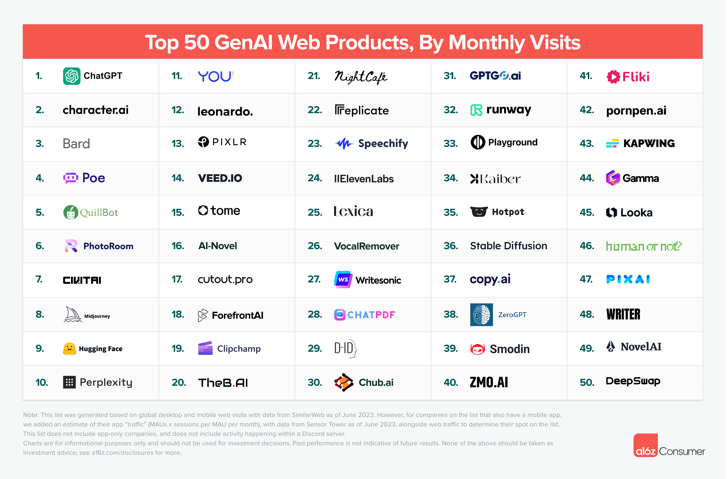
Notes:
https://a16z.com/how-are-consumers-using-generative-ai/

Slide 53
Pick One to Try and Share
Martin, your AI butler
Search GPT, if you’re tired of Googling things
Gist AI to summarize websites, YouTube videos, and PDF files
Jenova combines the best AI models, web search, and tools to amplify your productivity and empower knowledge
Goblin.Tools, a free chatbot for neurodivergent individuals with multiple tools
Napkin to create visuals from your text
Storydoc presentation creator
Creatify to make video ads for you
Numerous for work in Excel and Google Sheets
Suno for creating music
Jamboss to generate music with the iPhone app
Flux, a better image creator
Freepik image generator
Designrr to create ebooks, flipbooks, and websites from content you already have
Mindsmith to generate elearning units
Earkick, a free and anonymous self-care and AI chatbot
Choppity to quickly edit videos
Jamie AI, a bot-free notetaker for online and in-person meetings

Slide 54
Get with two other people in the room and introduce yourself and your role in your organization. Then discuss the tool you just tried. You have eight minutes to share.
What tool did you look at?
What does it do?
What did you like and/or not like about it?
How might you or someone in your organization use this tool?
What are your other favorite AI tools?

Slide 55
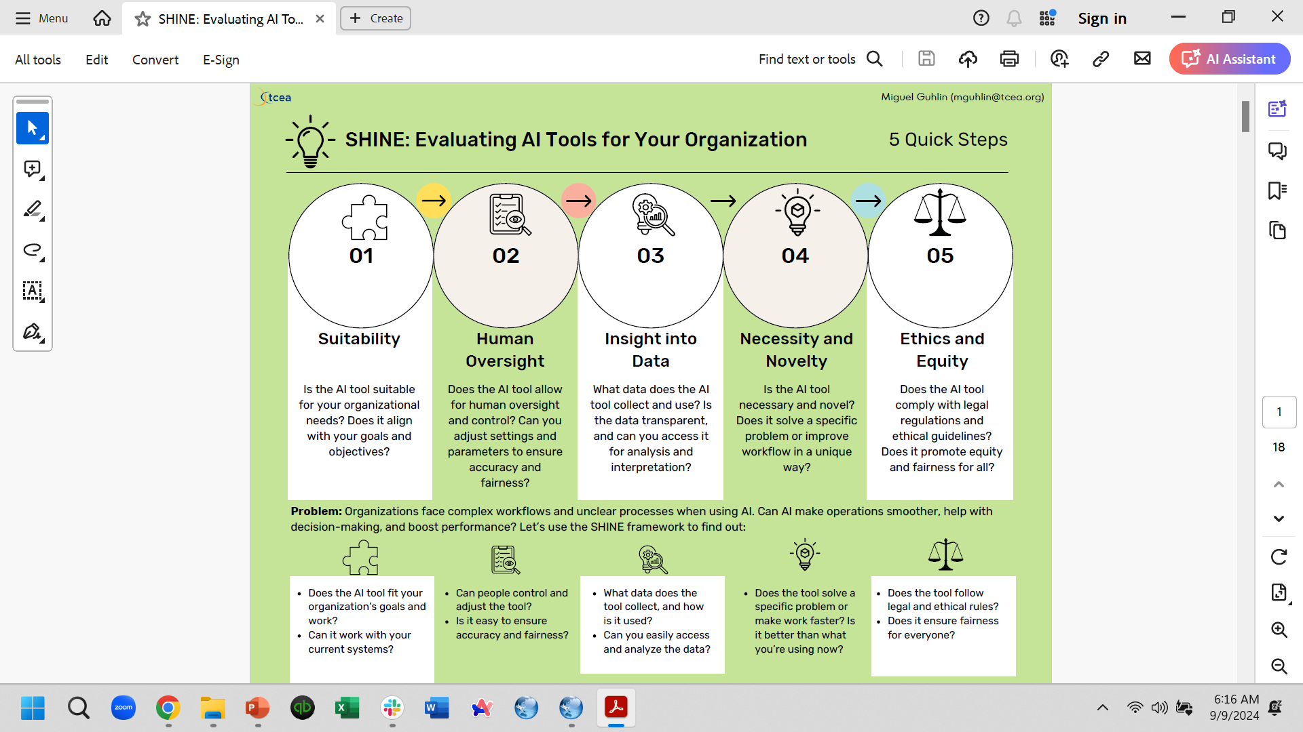
SHINE: Evaluating AI Tools for Your Organization

Slide 56


Slide 57
Who Is Responsible for AI Use in Your Organization?
No one?
Each staff member in charge of their own AI use?
One person in charge of everything?
Shared responsibility with IT, skill development specialist, and administration?
Shared responsibility with all staff?

Slide 58
Things to Consider for Your AI Policy
Written for staff, board, both, members?
Ethics/Fairness/Bias
Data privacy
AI tool selection and support
Professional learning
Connections
Organizational use

Slide 59
Ethics/Fairness/Bias
How do we ensure AI systems are fair, unbiased, and beneficial to all staff?
How do we ensure AI tools are transparent and explainable?
How do we address and prevent biases in ai-driven tools?

Slide 60
Data/Privacy
How can we balance productivity with privacy? What policies need to be in place?
Who is accountable when an AI tool fails or makes a mistake?
What data of ours will we share with customers? With AI? With the world?
AI Tools
How is the tool designed to fit a specific need?
What is the next AI application that's going to make waves, after generative AI? Where does that fit into our organization?

Slide 61
Professional Learning
Connections
What training is needed for staff to effectively oversee and utilize AI systems?
How can staff best utilize AI for themselves and their constituents?
How should AI be used to supplement vs. replace staff? Where do we draw the line?
How do we maintain human connection and relationships in an AI-enabled workplace?
What unique aspects of human learning can and cannot be replicated by AI?

Slide 62
Organizational Use
How might AI change the way staff members do their jobs?
What types of technological resources do staff need to work with AI, and what do the implementation gaps suggest about the areas where AI will be most effective?
How can we use the power of AI to better serve our community?
What surprising areas can AI impact that aren't often on people's radar?
How will we inform staff and customers about what is AI-generated?

Slide 63
Questions to Answer
Should there be disclosures for AI-created content? What will the human impact be of not knowing whether a human or AI created content?
Misinformation will become more strategic, infinitely easier to produce, and more credible at first glance, especially when combined with deep fakes. What can/should we do?
When should organizations develop their own AI instances, fed with controlled datasets?
AI now has what we'd call "general intelligence," the ability to "understand" across multiple fields and integrate them. What happens when AI develops what we call wisdom?

Slide 64

What Your AI Policy Should Address
Inaccurate, Unreliable, and Biased or Harmful Results
Laws and Regulations
Confidentiality of Company, Client, and Customer Information
Intellectual Property Rights, Plagiarism, and Terms and Conditions
Data Privacy Risks
Prohibited Uses of AI
Reporting and Prior Authorization

Slide 65
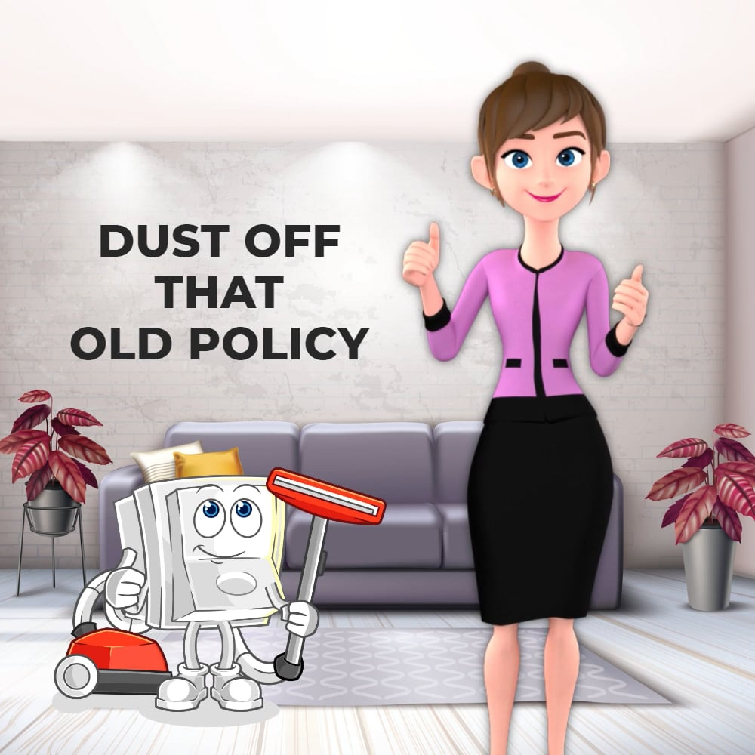
Not a “Write It and File It” Policy
Notes:
Your AI policy needs to be re-evaluated every four to six months.

Slide 66
Individually, in pairs, or in a small group, write a draft AI policy for your staff and/or organization. Be sure to consider the information in the previous slides. You have 25 minutes.
Look at the sample policies provided.
Go to your favorite chatbot and give it a detailed prompt to write the policy for you as a draft. Remember persona, task, context, and format.

Slide 67
Moving from Novel to Normal

Slide 68
Challenges for Nonprofits Using AI
Data safety concerns
Limited budgets and resources
Resistance to change (board, staff, and members)
Lack of technical expertise
Stakeholder buy-in

Slide 70
Notes:
TCEA’s Organizational AI Self-Assessment resource (https://tinyurl.com/orgaitracker)

Slide 71
Organizational AI Adoption Tracker
This custom GPT will help you to see where you are on the AI journey. At any time, you can type "Show report" to see the following:
Bar chart showing phase distribution
Line chart showing trends over time
Aggregate report data with the option to save it as a CSV (which you can open in Excel)
The GPT will ask for the organization being assessed, but it does not collect the person's name who is filling it out.
https://tinyurl.com/orgaitracker

Slide 72
Helping Novel Become Normal
Share
Share how you are using AI and how it is working for you.
Foster
Foster staff sharing of what is working and what isn’t.
Train
Continue to offer training and short updates on new features.
Educate
Educate staff about new, potential risks.

Slide 73
AI Notes from the ASAE 2024 Annual Meeting
AI Integration: Like it or not, AI is becoming an integral part of daily operations. From content creation to data analysis, it's already embedded in many tools associations use. The challenge? Leveraging AI to do more with less without losing the human touch.
Strategic Alignment: Don't fall for the "shiny object syndrome." AI adoption should be tied to your association's strategic objectives. Whether it's increasing content production or optimizing member services, AI should serve your mission, not dictate it.
Transparency: Be upfront about your AI use. If you're using AI to draft content or summarize meetings, let your members know. Transparency isn't just ethical – it's a trust-builder.
Ethical Considerations: Associations face unique ethical challenges with AI, including potential misinformation, bias, copyright issues, and data privacy concerns. Staying vigilant and establishing clear guidelines is crucial.
Evolving Policies: Your AI policies shouldn't collect dust. They need regular updates to keep pace with rapidly evolving technology and changing terms of service. Make them accessible, understandable, and reinforced through ongoing training.
Managing Shadow IT: Unmanaged AI tool usage can lead to security vulnerabilities and data inconsistencies. Clear policies and oversight are essential to prevent these risks.
Notes:
https://www.yokoco.com/navigating-the-ai-revolution-top-takeaways-from-asaes-2024-annual-meeting/

Slide 74
In your table group, select a facilitator (to keep the discussion going) and a timekeeper (to make sure all questions are discussed). Then discuss the following. You have 25 minutes:
What’s working for your organization with AI right now?
What challenges have you run into with AI and how have you dealt with those?
What’s your favorite AI tool and how have you used it for your organization?
What questions do you still need answered about using AI in your organization? How will you find the answers?

Slide 75

Next Steps

Slide 76
Define who is responsible for keeping up with and informing others about new developments in AI.
Develop an AI policy, getting buy-in from all stakeholders.
Provide detailed, hands-on professional learning for all staff. Allow for honest conversations about concerns.
Encourage exploration. Ensure that everyone is not afraid of trying and failing.
Spotlight success regularly.
Conduct ongoing evaluation and refinement of systems.
Provide and publish accountability and oversight measures.
Make sure not to get too caught up in the “shiny object” syndrome.

Slide 77

Stay Current!!
It’s critical to stay up to date with the growth in AI tools and resources. For example, OpenAI Japan’s CEO just stated (article is in Japanese) that “GPT-Next,” OpenAI’s upcoming AI model, is expected to be 100 times more powerful than GPT-4, while also confirming a more advanced model named Orion is slated for 2025.
The TCEA blog can help you stay current, as can these resources:
Ben’s Bites free daily enewsletter
The Neuron free daily enewsletter

Slide 78
Supporting AI Resources

Slide 79
Resources for Leaders
Nonprofits and AI: Managing and Other Risks
Ethical Considerations for Using Artificial Intelligence
K12 Generative AI Readiness Checklist Questionnaire (designed for school districts, but excellent for everyone)
NIST Artificial Intelligence Risk Management Framework
Top AI Guidelines for Associations to Follow
Developing Guidelines for the Use of Generative Artificial Intelligence in Local Government
Rubric for Evaluating AI Tools
Sample Online Meeting Recording Policy
AI Readiness Sprint (for training)

Slide 80
Resources for Supporting Boards
AI Stewardship for the Fit-for-Purpose Association Board: Part 1
AI Stewardship for the Fit-for-Purpose Association Board: Part 2
AI Stewardship for the Fit-for-Purpose Association Board: Part 3
Generative AI Considerations for Association Boards and CEOs: Part 1
Generative AI Considerations for Association Boards and CEOs: Part 2
Generative AI Considerations for Association Boards and CEOs: Part 3
AI and Nonprofits: What Boards Need to Know

Slide 81
Resources for Policy Development
Seven Things to Include in a Workplace Generative AI Policy
AI Policy Guide and Template for Not-for-Profit Organizations
An Example AI Policy Written by AI from the American Booksellers Association
Developing Policies to Govern AI from ASAE
A Framework toward Responsible and Beneficial AI for Fundraising
10 Tips for Creating a Generative AI Policy for Local Governments
City of Seattle Generative Artificial Intelligence Policy
Sample Policies

Slide 82
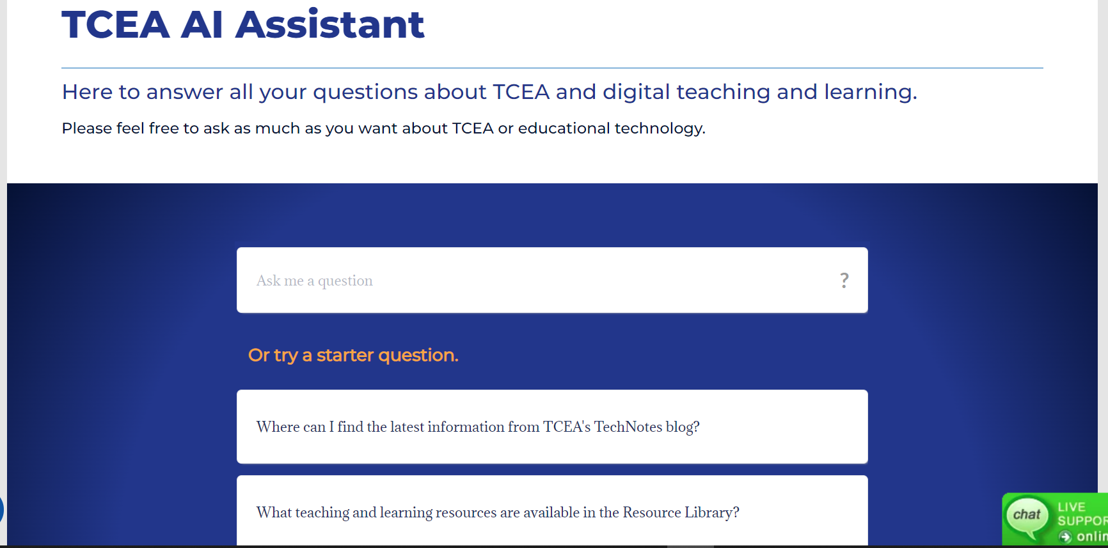
Creating Your Own Chatbot

Slide 83
Recommended Chatbot Platforms
My AskAI: Free 14-days trial; after that, $99.00/month for 1,000 conversations/month
Botpress: Free basic program; 2,000 incoming messages/month
Botsonic: Basic program $16/month for 1,000 messages; professional version $41/month for 3,000 messages
Chatbase: Free basic program; Hobby program $19/month for 2,000 messages; $99/month for 10,000 messages

Slide 84
Integrating a Chatbot on Your Website
Define the chatbot's purpose and goals.
Choose the right chatbot for your website.
Design your chatbot's conversation flow.
Train your chatbot on your content.
Integrate the chatbot into your website.
Test the chatbot.
Check periodically to see what your chatbot can’t answer or is answering incorrectly. “Teach” it any new content you develop.

Slide 85
Today’s Resources
https://shorturl.at/j2uLE

Slide 86


